Slide 1
Engineering Economics Course Project
David Eelman, Stanislav rashevskyi, Thomas abdallah

Slide 2
Assumptions
No tax credits or other incentives available for any generation option
100% utilization rate for all generation options
Same cost of financing for all generation options

Slide 3
Present Worth Analysis - Canada
No carbon tax required.

Slide 4
Present Worth Analysis - UK
No carbon tax required.

Slide 5
Incremental IRR Analysis
Wind + Solar + Diesel option selected by incremental IRR with no carbon tax applied (Canada & UK)
 | Diesel | Wind + Diesel | All | Solar + Diesel
Capital Cost | $44,352,000 | $74,614,320 | $76,466,016 | $79,695,000
Incremental IRR | N/A | 200.91% | 2787.10% | Negative incremental cash flows.

Slide 6
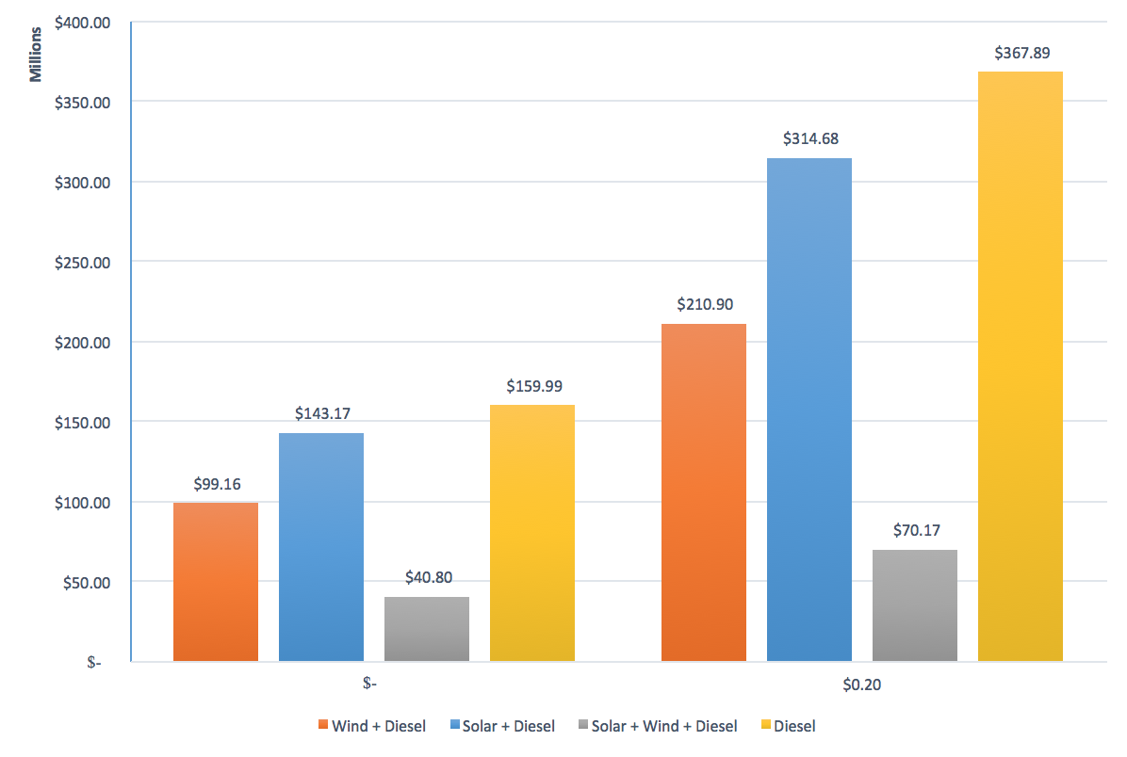
Equivalent Annual Cost
No carbon tax required.

Slide 7
Factors Missing & Conclusions
Conclusion: No carbon tax necessary to incent the adoption of renewable generation for this project.
Factors such as actual utilization rate and other government incentives have not been considered in this analysis.
Could impact the conclusions made.

